Slide 1
Digital Cameras in Microscopy
Kurt Thorn
Nikon Imaging Center @ QB3/UCSF

Slide 2
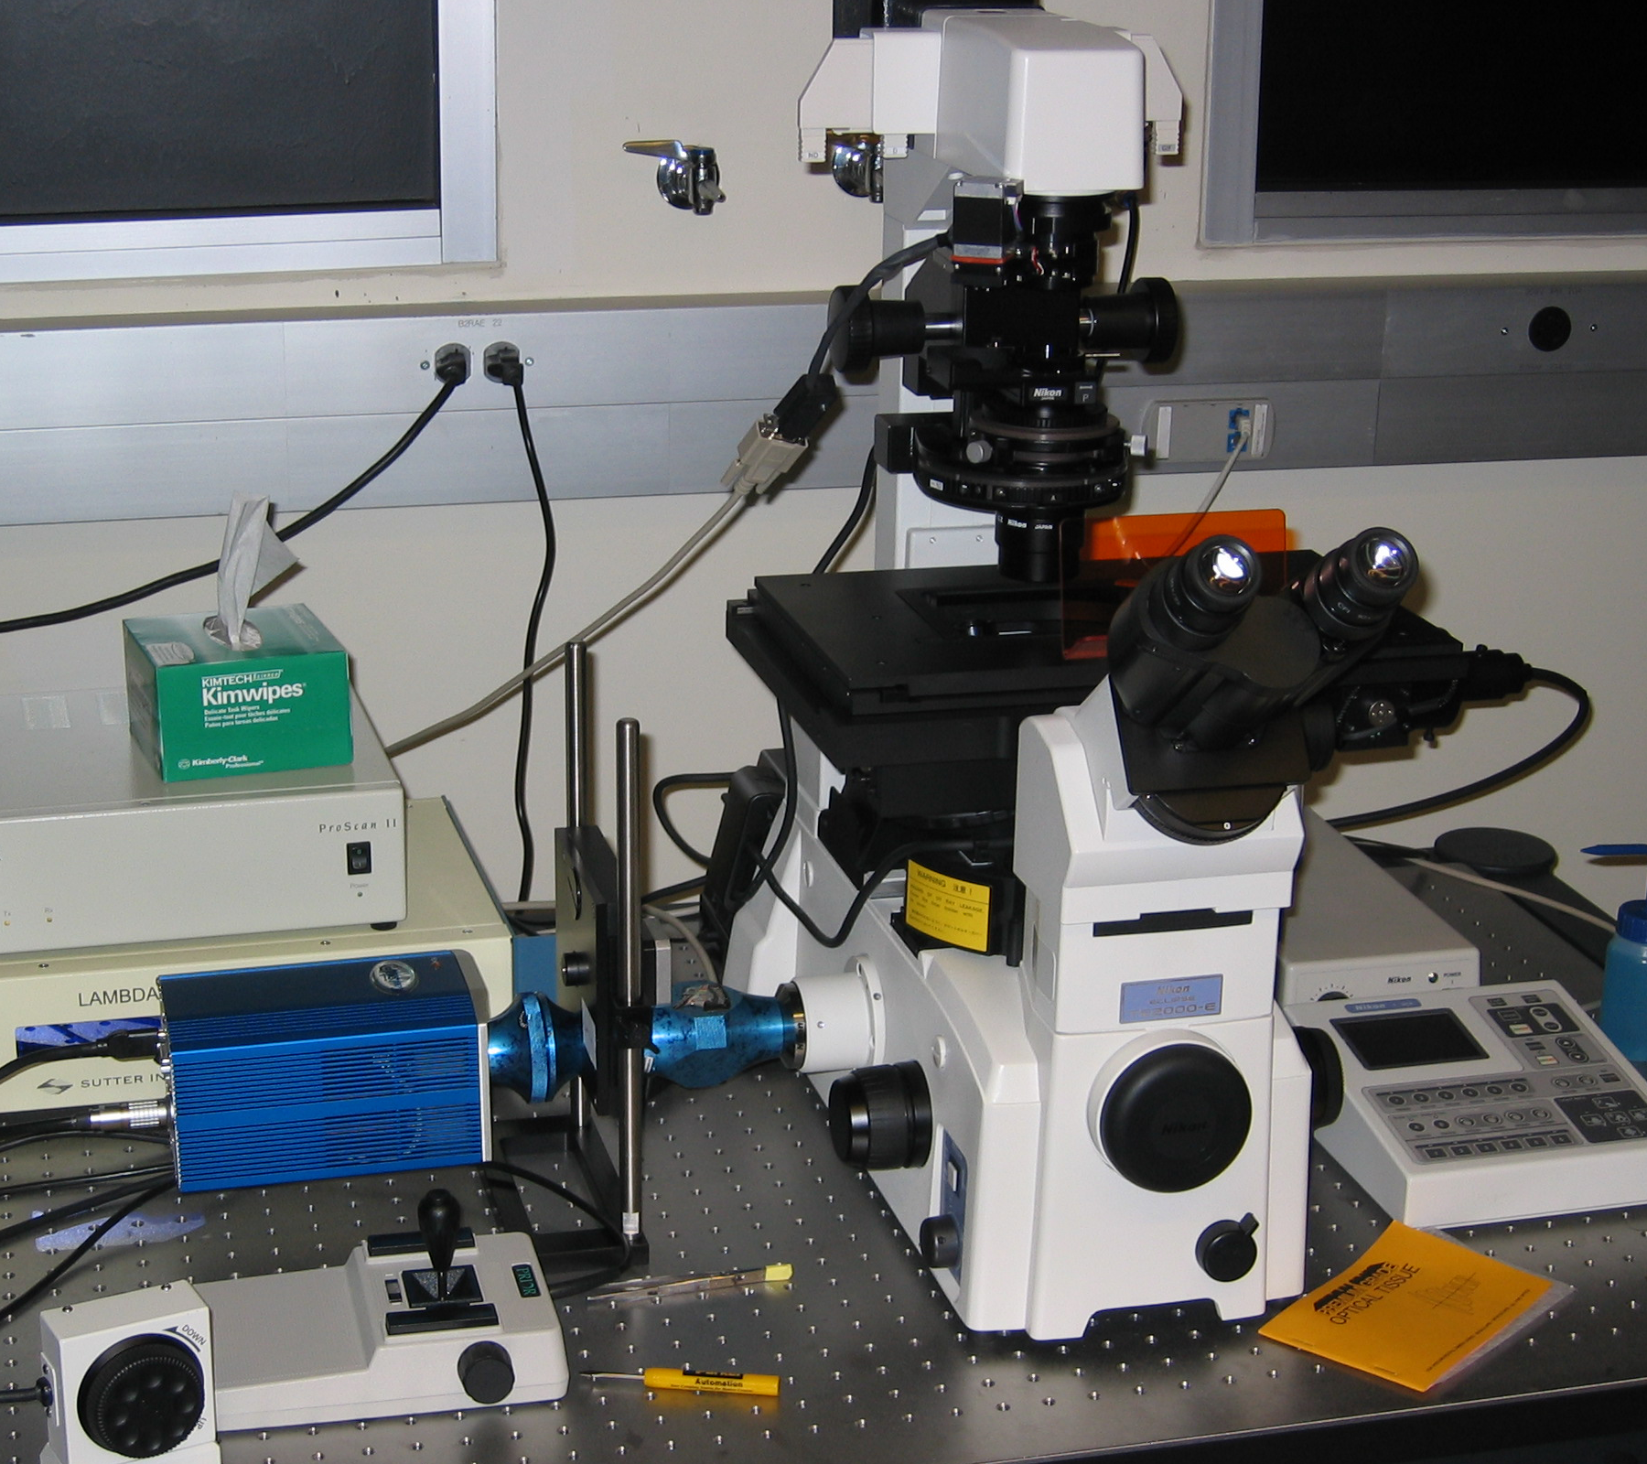

Slide 3
What does a camera need to do?
Convert light into an electrical signal
Accurately measure this signal
Do this in a spatially resolved way

Slide 4
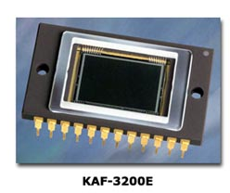
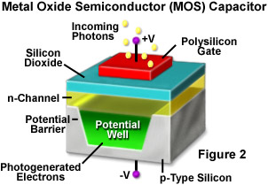
CCD architecture
…
…

Slide 5
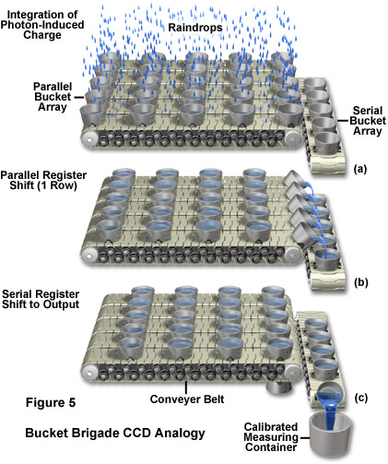
CCD readout “bucket-brigade” analogy

Slide 6
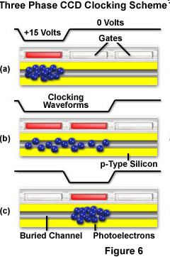
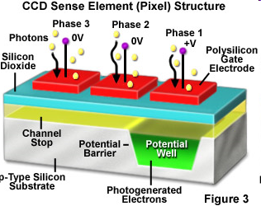
A little more realistic….
Each pixel is subdivided into three phases

Slide 7
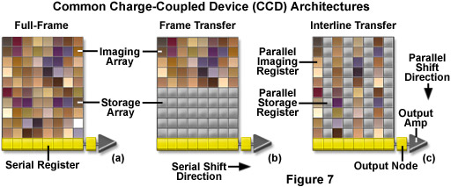
CCD Architectures
Rare
Mostly EMCCDs
Common
Full frame CCDs cannot acquire while being read out;
They also require a mechanical shutter to prevent smearing during readout.

Slide 8
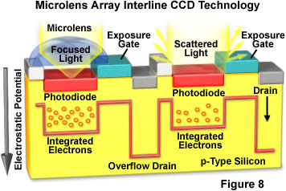
Interline CCDs and microlenses
Interline storage registers take up half the light gathering area on the CCD
Solution: use microlenses to focus light onto the light-gathering areas

Slide 9
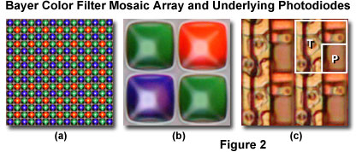
Why don’t we use color CCDs?
Four monochrome pixels are required to measure one color pixel
Your 5MP digital camera really acquires a 1.25 MP red and blue image and a 2.5 MP green image and uses image processing to reconstruct the true color image at 5 MP

Slide 10
Vital Statistics for CCDs
Pixel size and number
Quantum efficiency: the fraction of photons hitting the CCD that are converted to electrons
Full well depth: total number of electrons that can be recorded per pixel
Read noise
Dark current (negligible for most biological applications)
Readout time

Slide 11
Magnification and CCDs
1392
6.45 μm on a side
…
Chip is 8.98 x 6.71 mm on a side
1040
…
…
…
Typical magnification from sample to camera is roughly objective magnification

Slide 12
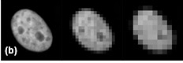
Resolution and magnification
More pixels / resolution element
Where is optimum?

Slide 13
Nyquist-Shannon Sampling
How many CCD pixels are needed to accurately reproduce the smallest object that can be resolved by the scope?
Nyquist-Shannon Sampling theorem: Must have at least two pixels per resolvable element
2.5 – 3 is preferable

Slide 14
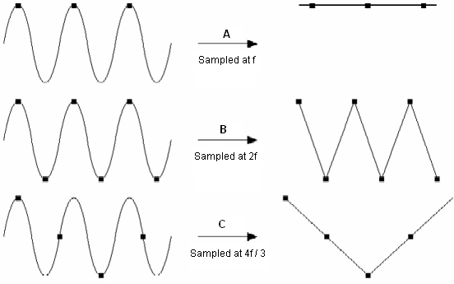
Nyquist-Shannon Sampling

Slide 15
Resolution and CCDs
Nyquist-Shannon Sampling theorem: Must have at least two pixels per resolvable element
E.g: if your resolution is 300 nm, your image should be magnified to so that 150 nm in the sample corresponds to at least one pixel on the camera
If you fail to do this, you will miss features smaller than twice your sampling size
You can also run into aliasing problems

Slide 16
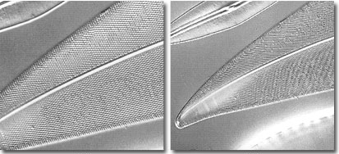
Aliasing
Nyquist sampled
Undersampled

Slide 17
A resolution-centric view of imaging
The objective NA sets the highest resolution you can measure (1.4 NA ~ 220 nm)
To achieve this resolution, 220 nm in your image must cover 2 pixels
Choose your magnification to achieve this
For 6.45 μm pixels, we need a total magnification of 6450/110 = 58.6
So for 1.4 NA, a 40x lens would be undersampled, a 60x would be just at the Nyquist limit, and a 100x lens would oversample

Slide 18
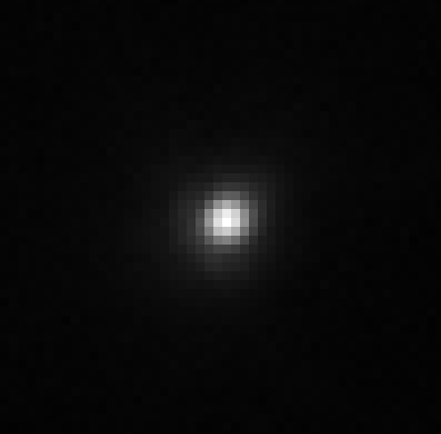
Actual PSF

Slide 19
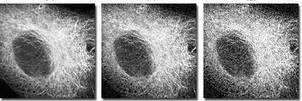
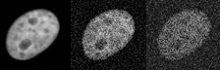
Noise
Longer exposure times are better – why?
Increasing exposure time

Slide 20
Noise
Read noise – inherent in reading out CCD
Scales as the square root of readout speed (faster = noisier)
For CoolSNAP HQ2: 4.5 e⁻ / pixel @ 10MHz (180 ms readout)
5.5 e⁻ / pixel @ 20MHz (90ms readout)
Dark current – thermal accumulation of electrons
Cooling helps, so negligible for most applications
CoolSNAP HQ2: 0.001 e⁻ / pixel / s (@ -30°C)

Slide 21
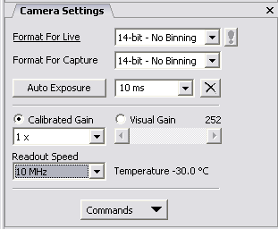
Noise
Photon Shot Noise: Due to the fact that photons are particles and collected in integer numbers
Square root of the number of photons
1 photon ≠ 1 count in your image – depends on the camera (A/D) gain
Zero photons collected doesn’t result in zero being measured on the camera – it has an offset

Slide 22
Signal/Noise Ratio (SNR)
Signal = # of photons
Noise = √ (read noise² +(# of photons))
At low photon numbers, read noise dominates
At high photon numbers, SNR = (# of photons)/ √(# of photons) = √(# of photons)
So, to double your SNR, you need to acquire four times as long (or 2x2 bin)

Slide 23
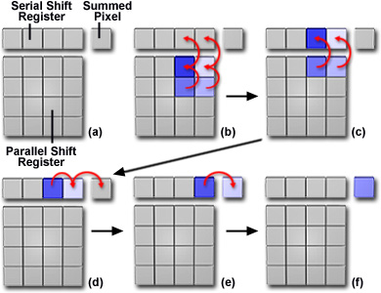
Binning
Read out 4 pixels as one
Increases SNR by 2x
Decreases read time by 2 or 4x
Decreases resolution by 2x

Slide 24
Signal/Noise Ratio (SNR)
Read noise dominates whenever read noise² = # of photons
8 e- read noise → 64 photons
16 e- read noise → 256 photons
50 e- read noise → 2500 photons
Full range on Coolsnap HQ2 with 4x gain: 4095 photons

Slide 25
What does this look like?
1000 photons / pixel on average; ~5000 in brightest areas
Test image
no read noise
5 e⁻ read noise
Photon shot noise ~ 6x read noise

Slide 26
What does this look like?
100 photons / pixel on average; ~500 in brightest areas
Test image
no read noise
5 e⁻ read noise
Photon shot noise = 2x read noise

Slide 27
What does this look like?
25 photons / pixel on average; ~125 in brightest areas
Test image
no read noise
5 e⁻ read noise
Photon shot noise = read noise

Slide 28
What does this look like?
10 photons / pixel on average; ~50 in brightest areas
Test image
no read noise
5 e⁻ read noise
Photon shot noise ~ 2/3 read noise

Slide 29
What does this look like?
1 photon / pixel on average; ~5 in brightest areas
Test image
no read noise
5 e⁻ read noise
Photon shot noise ~ 1/5 read noise

Slide 30
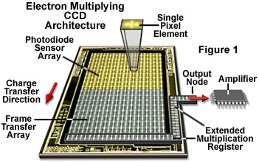
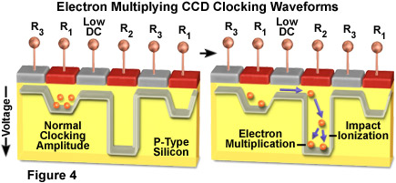
Beating the read-out noise EMCCD

Slide 31
EMCCD result
Fast noisy CCD – runs at 30 fps, but 50 e⁻ read noise
Multiply signal by 100-fold – now read noise looks like 0.5 e⁻
Downside – multiplication process adds additional Poisson noise, so your QE looks like it’s halved
Upside – you get to image fast without worrying about read noise

Slide 32
Hypothetical CCD/EMCCD comparison
100 photon / pixel on average; ~500 in brightest areas
Slow scan CCD
4e⁻ read noise
(1 sec read time)
Video rate CCD,
50e⁻ read noise
Video rate EMCCD
50e⁻ read noise
200x gain

Slide 33
CCDs vs. CMOS
CCDs:
Output electrons
Off chip amplifier and A/D converter generate output signal
Slow, low noise
CMOS
Outputs digital signal
Each pixel has its own amplifier; each row has its own A/D converter
Fast, noisy

Slide 34
New: sCMOS
Scientific CMOS
Like CMOS, but better
Differences are proprietary
Vendors: Hamamatsu, Andor, PCO
Specs (Andor Neo):
5.5 megapixels (2560 x 2160)
6.5 μm pixels
100 fps readout
1.5 e⁻ read noise

Slide 35
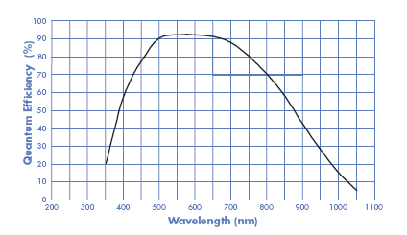
Quantum efficiency
HQ2
Cascade II

Slide 36
How many intensity levels can you distinguish?
Full well capacity (16 000 e⁻)
Readout noise: 5e-
Dynamic range:
FWC/readout noise: 3200
0.9 * FWC / (3 * readout noise) = 960
(Human eye ~ 100)

Slide 37
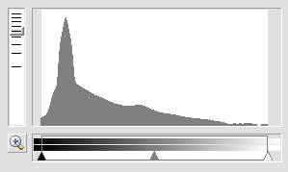
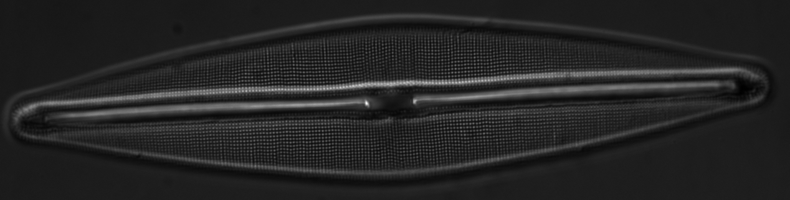
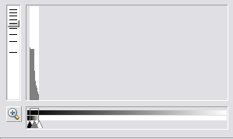
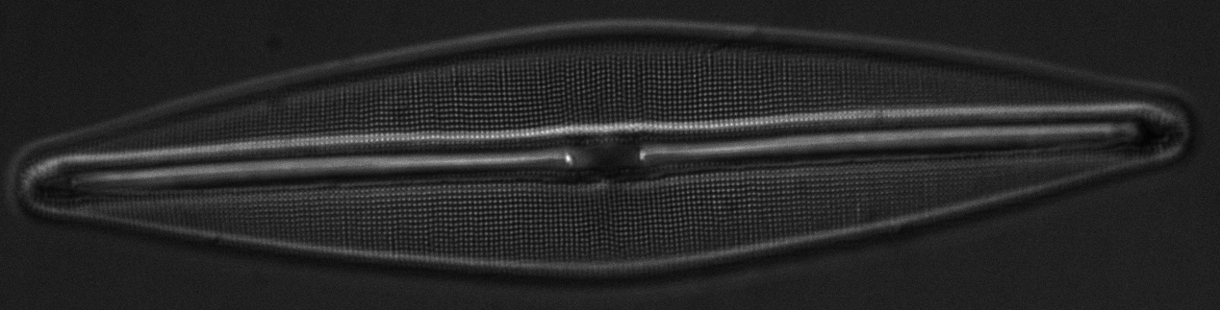
Check your histogram
# of
pixels
Intensity

Slide 38
Improve Signal/noise
Use bright, non-bleaching fluorophores
Best possible optics (high NA lenses, high QE camera, high transmission filters, reduce spherical aberration, no phase!)
Minimize optical elements between your sample and the camera (use bottom port!)
Work in the dark, use clean cover slips, reagents, etc..
Increase exposure or use frame averaging
Binning (at the expense of spatial resolution)

Slide 39
Acknowlegdements
www.microscopyu.com
Nico Stuurman
James Pawley, Ed. “Handbook of Biological Confocal Microscopy, 3rd ed.), especially appendix 3: “More than you ever really wanted to know about charge-coupled devices”
James Janesick, “Scientific Charge Coupled Devices” (if you really, really, want to know about CCDs)

